Slide 1







Mehdi Khalili
Readify
Live Backchannel: #dddbrisbane #web01
Advanced Web Debugging
with Fiddler

Slide 2

Advanced Web Debugging with Fiddler
Mehdi Khalili
Readify
Blog: www.Mehdi-Khalili.com
Twitter: @MehdiKhalili
Email: me@mehdi-khalili.com

Slide 3
Please leave your questions to the end
Tight schedule
Your answer may be in the next slide
We will have a Q&A at the end
If we run out of time:
Do not hesitate to shoot me an email with your questions
You can also read an extensive two part tutorial on my blog:
http://www.mehdi-khalili.com/fiddler-in-action/part-1
http://www.mehdi-khalili.com/fiddler-in-action/part-2

Slide 4
Agenda
What is Fiddler and how does it work?
Alternative tools
Fiddler features
FiddlerCore and FiddlerCap
Quick tour of remaining features
Q&A
Lots of positive feedback and tweets from you ;-)

Slide 5
What is Fiddler?
A Web Debugging Proxy
It is free and has millions of users
A necessary tool in a developer’s toolbox!!

Slide 6
Fiddler features in a nutshell
With Fiddler you can perform:
HTTP(S) traffic monitoring and Analysis
HTTP request and response modification

Slide 7
What is HTTP again?
A networking protocol
In the application layer
Sits on top of TCP protocol (usually)

Slide 8
HTTP Session
An HTTP communication is called a session
An example of that is web browsing:
You type an address in your browser
Your browser does a DNS lookup for the URL
Then creates a TCP connection to the server
And creates and sends an HTTP request
The server receives the request
Processes it (and optionally maps it to a resource)
And creates and returns an HTTP response

Slide 9
HTTP Request
An HTTP request is composed of:
A request line
Header lines
A blank line
An optional body
GET http://www.google.com.au/ HTTP/1.1
Host: www.google.com.au
Connection: keep-alive
Accept: text/html,application/xhtml+xml,application/xml;
Accept-Encoding: gzip,deflate,sdch
Accept-Language: en-US,en;q=0.8

Slide 10
HTTP Response
An HTTP response is composed of:
A status code
Header lines
An optional body
HTTP/1.1 200 OK
Date: Tue, 22 Nov 2011 20:38:20 GMT
Expires: -1
Cache-Control: private, max-age=0
Content-Type: text/html; charset=UTF-8
Server: gws
Content-Length: 57556

Slide 11
Back to Fiddler: Where to get it from?
http://www.fiddler2.com
Application
Documentation
Fiddler extensions

Slide 12
How does it work?

Slide 13
Demo
fiddler and WinINet

Slide 14
If you can use a proxy you can use Fiddler
PC
Mac
Fiddler
Web Server
Linux
Mobile

Slide 15
What is next?
What is Fiddler and how does it work?
Alternative tools
Fiddler features
FiddlerCore and FiddlerCap
Quick tour of remaining features
Q&A
Lots of positive feedback and tweets from you ;-)

Slide 16
Alternatives and similar tools
Packet Analysers:
WireShark
NetMon
Proxies:
Charles
Burp Suite
Browser Dev Tools:
HttpWatch for IE and FireFox
FireBug for FireFox
Chrome developer tools and FireBug Lite for Chrome
IE Dev Tools

Slide 17
Sniffer vs Proxy vs Browser Dev Tools
Feature | Sniffer | Proxy | Browser Tools
HTTP only | No | Yes | Yes
Nice visualisation | No | Yes | Yes
From all processes | Yes | Yes | Only Browser session
Local traffic | No | Yes | Yes
Cached traffic | No | No | Yes

Slide 18
What is next?
What is Fiddler and how does it work?
Alternative tools
Fiddler features
FiddlerCore and FiddlerCap
Quick tour of remaining features
Q&A
Lots of positive feedback and tweets from you ;-)

Slide 19
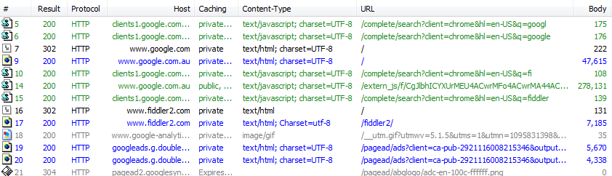
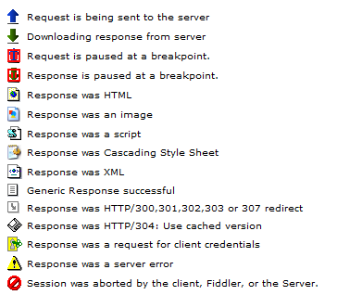
HTTP(S) Traffic
Result - The Result code
Protocol - HTTP/HTTPS/FTP
Host - The hostname
URL - The path and file requested from the server
Body - The number of bytes in the response body
Caching - Response's Expires or Cache-Control headers
Process - The local Windows Process
Content-Type - The Content-Type header

Slide 20
Demo
HTTP Traffic

Slide 21
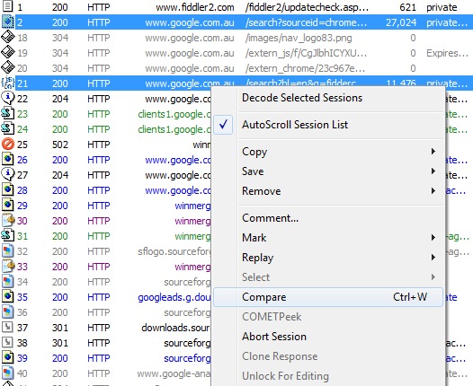
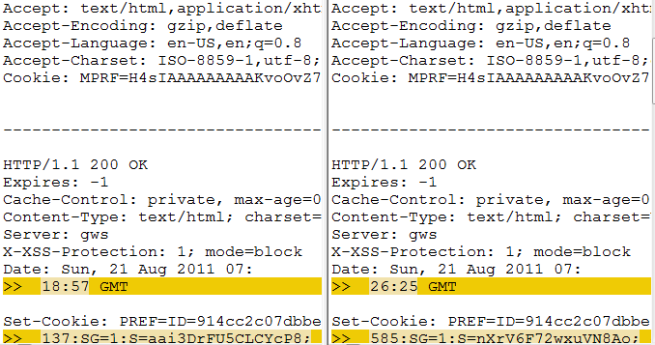
Traffic Comparison
Compare sessions using a diff tool

Slide 22
Demo
Traffic Comparison

Slide 23
Traffic Comparison
It allows you to compare two sessions
If you want to compare two traffic profiles then use Traffic Differ extension

Slide 24
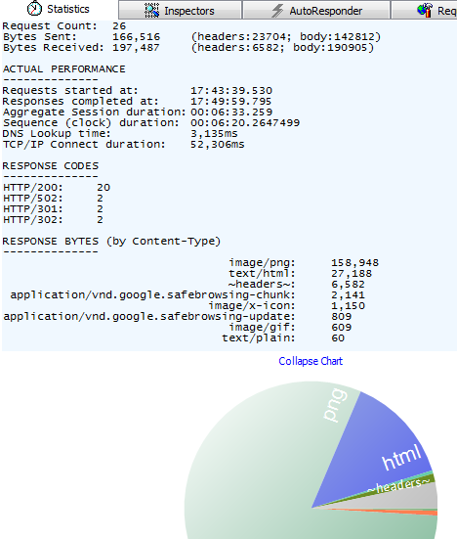
Statistics
Get a "total page weight and wait"—the number of requests and the bytes transferred.

Slide 25
Demo
Statistics tab

Slide 26
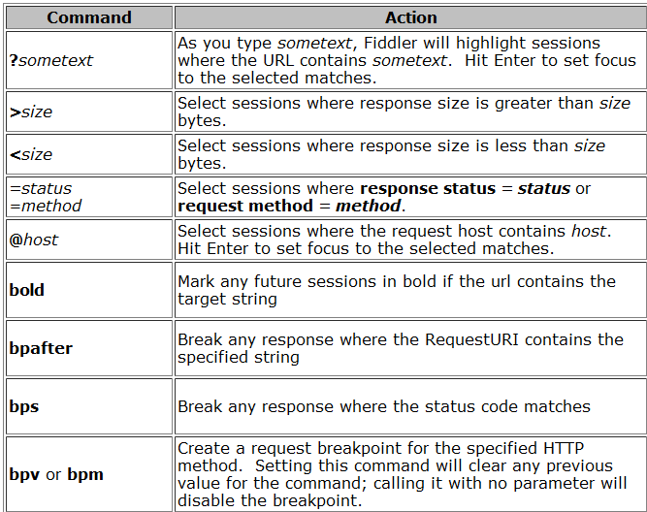
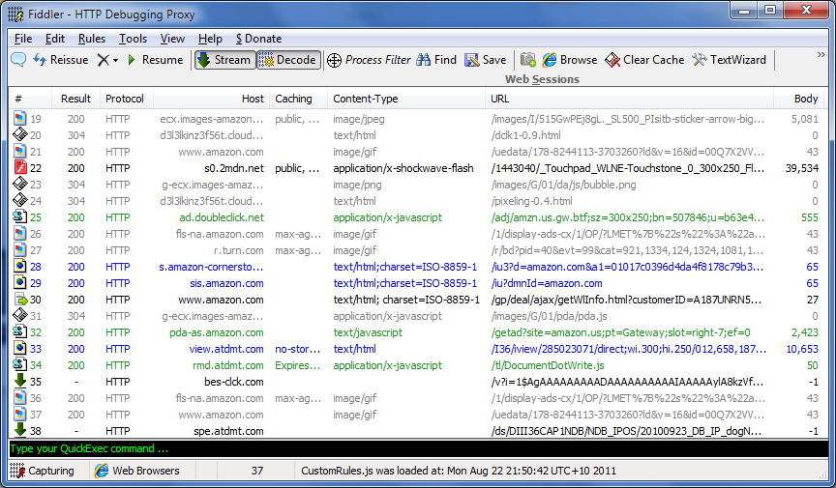
Quick Exec

Slide 27
Demo
A few handy QuickExec Commands

Slide 28
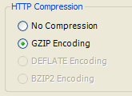
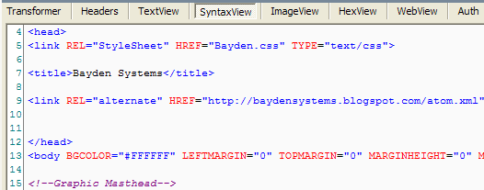
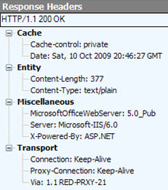
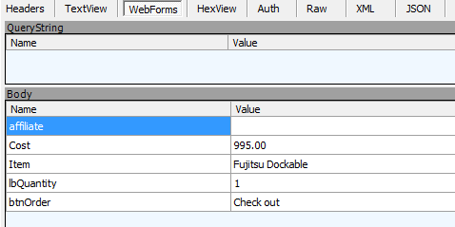
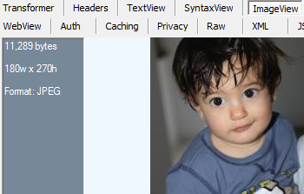
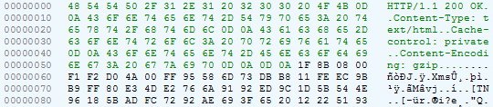
Inspectors
Inspectors allow you to visualize requests and responses in meaningful ways.

Slide 29
Demo
Inspectors

Slide 30

HTTPS Traffic Decryption
Fiddler can decrypt HTTPS traffic using the Man-In-The-Middle attack

Slide 31
HTTPS Traffic Decryption
Fiddler can decrypt HTTPS traffic using the Man-In-The-Middle attack
Man In The Middle Attack
1
Client
MITM
Server
2

Slide 32
HTTPS Traffic Decryption
Fiddler can decrypt HTTPS traffic using the Man-In-The-Middle attack
Man In The Middle Attack
Client
1
MITM
2
Server
4
3

Slide 33
Demo
Setting up HTTPS decryption

Slide 34
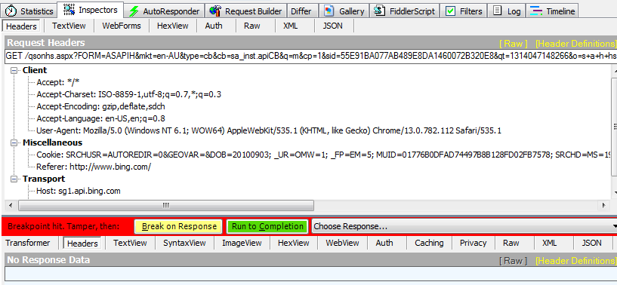
Changing the traffic on the fly
You can set breakpoints and change the request and/or response on the fly. Fiddler is the MITM.

Slide 35
Demo
How to set breakpoints
And
change Requests and/or responses

Slide 36
Changing the traffic on the fly
Test your JavaScript code with less than perfect response
Test your website for security holes
Troubleshoot your third party web client
Troubleshoot your third party web service

Slide 37
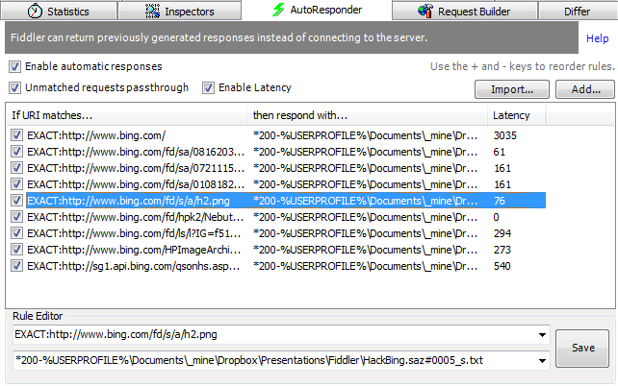
Auto Responder
Create a fake web server using Auto Responder

Slide 38
Demo
How to setup and use Auto Responder

Slide 39
Auto Responder
Replace a JavaScript or css or image file
Replace an entire traffic
Force a redirection
Work without a connection!

Slide 40
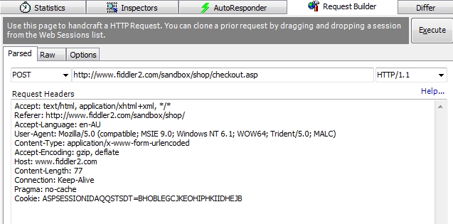
Request Builder
Create a fake web client using Request Builder
Avoid coding html pages or test clients. Use Request Builder instead to send a hand rolled request to your server/service

Slide 41
Demo
How to setup and use request builder

Slide 42
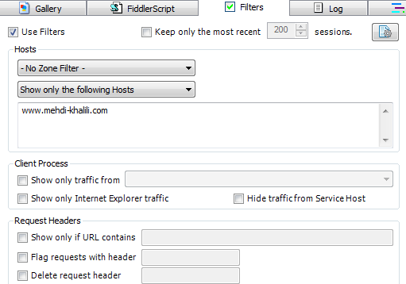
Filters
Filter and flag traffic and perform some lightweight modifications

Slide 43
Demo
quick tour of filters

Slide 44
Filters
Clean up your Web Sessions page
Filter out some status codes
Filter out traffic from some urls
Flag some of the traffic
Very useful on a high traffic server/machine

Slide 45
What is next?
What is Fiddler and how does it work?
Alternative tools
Fiddler features
FiddlerCore and FiddlerCap
Quick tour of remaining features
Q&A
Lots of positive feedback and tweets from you ;-)

Slide 46
Fiddler Core
Fiddler application with extensions
Your application hosting FiddlerCore
Fiddler 2
YourApp.exe
Inspector2
ExecAction.exe
Inspector2
IFiddlerExtension
IFiddlerExtension
Fiddler ScriptEngine
Your FiddlerScript
FiddlerCore
FiddlerCore
Xceed*.dll
Makecert.exe
Xceed*.dll
Makecert.exe

Slide 47
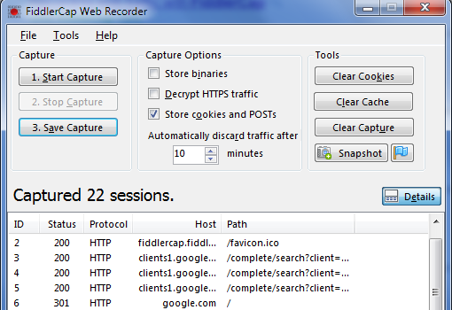
FiddlerCap
Built on top of FiddlerCore
It is bin deployable
A handy tool for production support

Slide 48
Demo
Fiddler Cap

Slide 49
Quick Summary
As a quick summary here is the list of Fiddler features you are likely to use more
Requirement | Feature
Watch the traffic | Web Sessions
Compare two sessions | Web Sessions -> compare
Run commands | QuickExec
Inspect requests & responses | Inspectors
Fiddle with the traffic | Breakpoints + Inspectors
Return an HTTP response locally | Auto Responder
Make an HTTP request | Request Builder
Filter and flag sessions | Filters
Fiddler for end user | FiddlerCap

Slide 50
What is next?
What is Fiddler and how does it work?
Alternative tools
Fiddler features
FiddlerCore and FiddlerCap
Quick tour of remaining features
Q&A
Lots of positive feedback and tweets from you ;-)

Slide 51
Demo
Quick tour of what is not covered

Slide 52
Extensions
SyntaxView
WcfBinaryInspector
Traffic Differ
Gallery
neXpert Performance Report Generator
StresStimulus aids in load-testing
Find out more on Fiddler website

Slide 53
That is all from me
What is Fiddler and how does it work?
Alternative tools
Fiddler features
FiddlerCore and FiddlerCap
Quick tour of remaining features
Quick overview of useful extensions
Q&A
Lots of positive feedback and tweets from you ;-)

Slide 54
Thanks for attending
Q&A
Tutorials:
http://www.mehdi-khalili.com/fiddler-in-action/part-1
http://www.mehdi-khalili.com/fiddler-in-action/part-2
Contact Details:
Email: me@mehdi-khalili.com
Twitter: @MehdiKhalili

